Slide 1
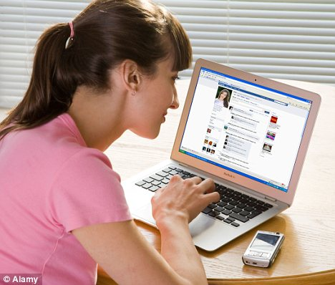
Involved in
Taking care of family and home.
Key Responsibilities
Home life is hectic for Alice as she has all the children and home responsibilities.
Alice Wonderland
Stay at home mom
Staying connected to friends and family
She tries to stay connected to friends and family through sharing posts and liking and commenting on their posts.
Free of Cost communication service
Facebook App is free to use for everyone.
Many users around the world
Facebook has many users. Almost everyone she knows has an account on facebook.
IT/Technical Knowledge
Web/Social Media Usage
Language Editing
Eye for the Details
Video Development
Drivers
Tech Profile
Learning to use the facebook app
She is not sure if she has downloaded the app properly and is using it effectively.
Many ways to share
Sometimes she gets confused by the many ways to share and connect through the facebook app.
Notifications
She is trying to figure out the notifications that come through the facebook app
Frustrations

